Slide 1
British sights

Slide 2
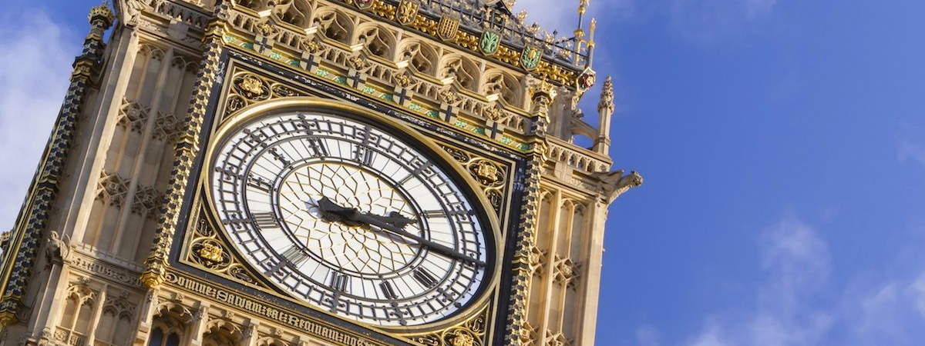
A. The tower of London b. big ben
What is this?

Slide 3
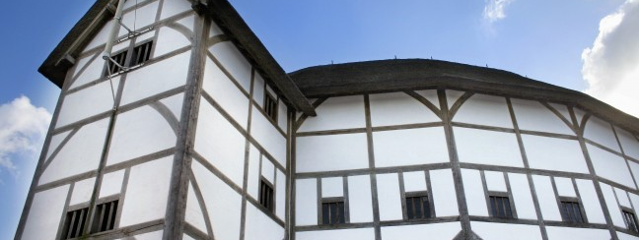
a. Shakespeare’s globe b. Arts theatre
What is this?

Slide 4
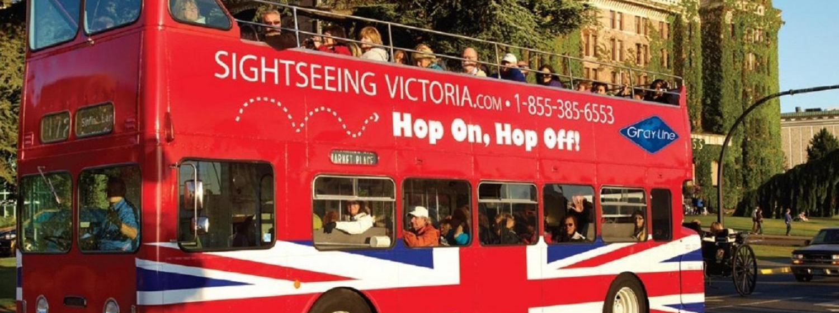
a. Taxi cab b. double-decker
What is this?

Slide 5
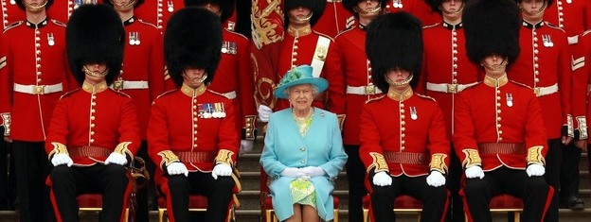
a. Buckingham Palace Guards b. Queen’s Guards
What is this?

Slide 6
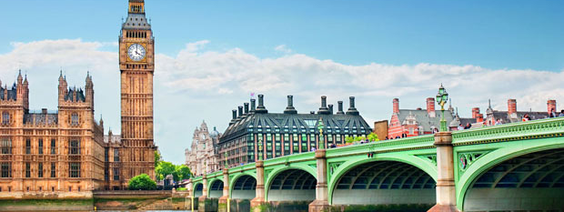
a. Westminster bridge b. Lambeth bridge
What is this?

Slide 7
Thank you for attention

